Slide 1

Lecture 8: IT in Government
Hoger Mahmud

Slide 2



Lecture outline
What is a government
What is eGovernment
Services of eGovernment
Examples of eGovernment systems
Benefits of eGovernmnet
2

Slide 3
What is a Government
Simply, a government guides the members of a community in their dealings with each others and outsiders.
A judicial power to interpret the laws
Government
A legislative power to make laws
An executive power to carry out the laws
3

Slide 4
Types of Government
Healthcare Democracy: government is elected by the people
Autocracy: Government by a single person having unlimited power
Oligarchy: A government in which a few people such as a dominant clan have power.
Monarchy: A monarchy has a king, queen, emperor or empress
Dictatorship: A country ruled by a none elected single leader
Capitalist: In a capitalist or free-market country, people can own their own businesses and property
Communist: the government owns property such as businesses and farms
Anarchy: Anarchy is a situation where there is no government
4

Slide 5
What is eGovernment
It is the transformation of government to provide
Services to the Citizens & Businesses
Through
Information & Communication Technologies
5

Slide 6
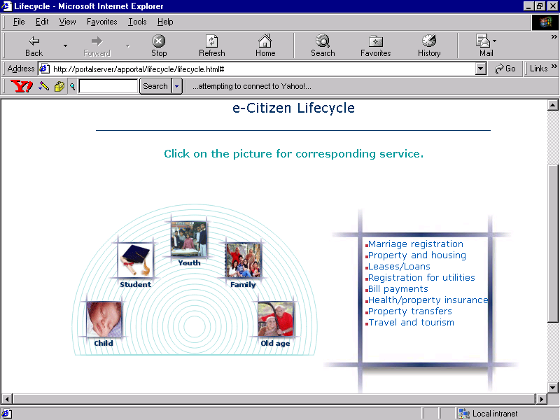
Examples of e-Services – G2C
Employment Services
Vehicle Registration
Driver’s License
Passport/Visa
Agriculture
Land Record
Property Registration
Marriage Certificates
Taxes
Utility Services
Municipality Services
School Admission
Scholarships
e-Learning
Examination Results
Pensions
Insurance
Health Care
Death Certificate
Birth Certificate
Health Care
6

Slide 7
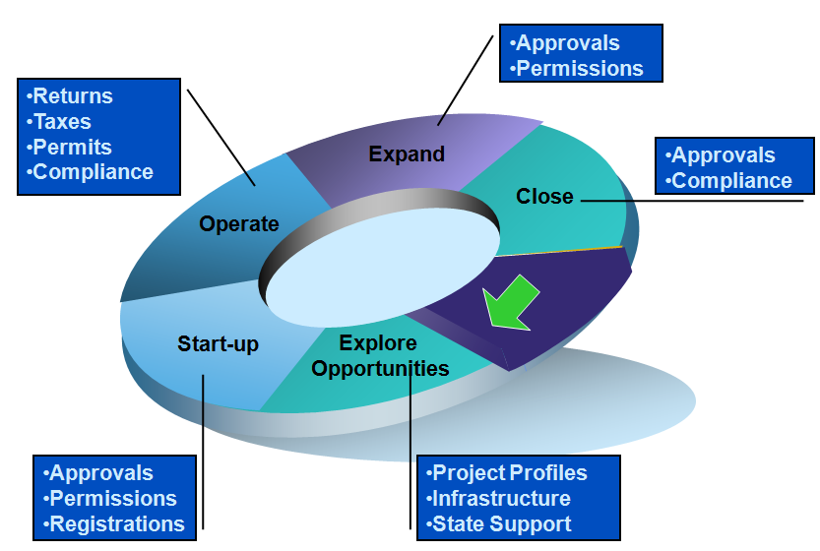
Examples of e-Services – G2B
7

Slide 8
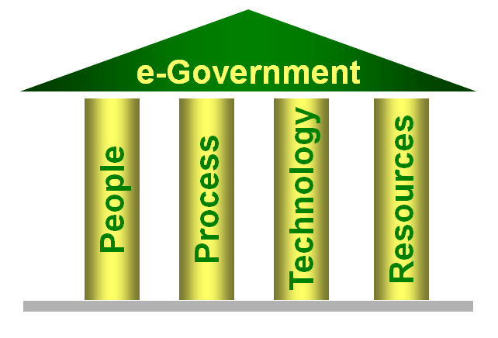
The four pillars of eGovernment
8

Slide 9
eGovernment obstacles
1 PROCESS
2 PEOPLE
Lack of Process Models
Status Quo-ism
Poor Legal Frameworks
Complex Procurement
Lack of Political Will
Official Apathy
Shortage of Champions
Lack of Skills in Govt
4 RESOURCES
3 TECHNOLGY
Budget Constraints
Disinterest of Pvt Sector
Lack Project Mgt Skills
Lack of Architectures
Lack of Standards
Poor Communication
Infrastructure
Hardware-approach
9

Slide 10
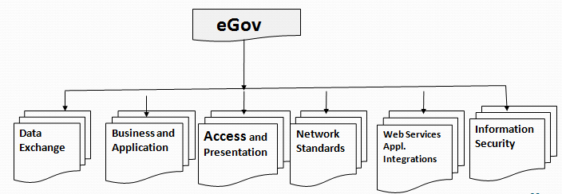
eGovernment requirements
10

Slide 11
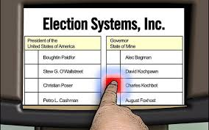
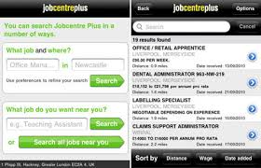
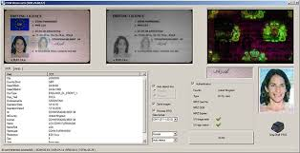
eGov Software example
eVote
eJob
eID
11

Slide 12
Benefits of eGovermnet
Cost and time-savings
Certainty in getting services
Better quality of life
Ease of access of information
Added convenience – multiple delivery channels
Possibility of self-service
More transparency
12

Slide 13

Thank you
?

